Slide 1

DOES TRAVEL DISTANCE MATTER FOR BADMINTON ATHLETES?
ANDREW ZHUANG

Slide 2

TABLE OF CONTENTS
Introductory Message SECTION ONE | Hypothesis SECTION TWO
Details of Experiment SECTION THREE | Experiment Results SECTION FOUR | Conclusion SECTION FIVE

Slide 3

HYPOTHESIS
Travel will affect badminton players in a negative way in terms of performance.

Slide 4

DISTANCE TRAVELLED
Travelling can be very taxing!
When do Athletes choose to travel?

Slide 5
DETAILS OF EXPERIMENT: MEASURES
Our experiment will attempt to answer the hypothesis with two difference measures:
1
Given the distance travelled for two players, we will see if it is more likely that the shorter distance travelled player wins.
Does a player reach further rounds on average in their home country compared to away?
2

Slide 6
DETAILS OF EXPERIMENT: DATA PREP
DATA | TOOLS
Scraped data from: http://bwf.tournamentsoftware.com | Python: pandas, requests, beautifulSoup, re Pipeline built to scrape tournament links: get tournament links -> get match pages -> scrape key information -> export as csv

Slide 7
DETAILS OF EXPERIMENT: DATA PREP
Formatting the data
ArcGIS to calculate distance
Winner/loser information, distance information, rounds won

Slide 8
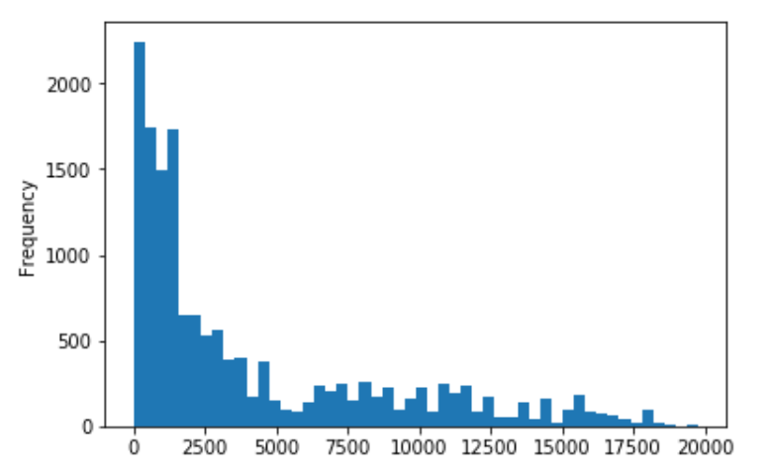
EXPERIMENT RESULTS: MATCH WINS VS DISTANCE
Winner Distances
Samples: 15575
Mean: 4132
Variance: 4638
Loser Distances
Samples: 15575
Mean: 3412
Variance: 4316

Slide 9
EXPERIMENT RESULTS: MATCH WINS VS DISTANCE
We have equal variances (assumption), independent samples and ordinal values
Mann-Whitney U test
H_0: P(W_d>L_d) = P(L_d>W_d) where W_d and L_d represent the Winner distance distribution and Loser distance distribution respectively
H_1: P(W_d>L_d) ≠ P(L_d>W_d)
Uses a ranking method to create a test statistic U.
Our test statistic: 107780893.500, p value < 0.01
Reject H_0.

Slide 10
EXPERIMENT RESULTS: SCRUBS RUINING MY HYPOTHESIS!??
Cutting the data so it’s player specific. Player win distances and loss distances
Means: 3260 and 3236, SD: 3807 and 3608
P value for Mann-Whitney U test: p=0.037 / Removing scrubs (matches played < 6) p = 0.062
Distributions are closer than before, but this does indicate that the “scrubs” have some affect to the winning/losing distances
Removing scrubs players from match data set reduced the test stat by 10% as well

Slide 11
EXPERIMENT RESULTS: HOME COURT ADVANTAGE
Home court advantage done similarly, but collecting average rounds per player
Home rounds mean: 2.6
Away rounds mean: 2.25
Variances were not as close (2.05 vs 2.6)
Mann-Whitney U test and Wilcox Signed rank test P value < 0.01

Slide 12
EXPERIMENT RESULTS: BONUS
I created ranking values for players based of the TRUESKILL package. Used this to try and predict the winners for the last 200 matches in the dataset
With just the ratings, for men’s singles we had an accuracy of 49% for each match
Decided to add in distance and home court as a feature and use a random forest Classifier for predictions
Accuracy jumped to 70%

Slide 13
CONCLUSION VALIDATED LEARNING AND NEXT STEPS
Initial hypothesis that travel negatively affects badminton player performance does not appear to be widespread
Tournament distance travelled tend to be local and local “scrubs” will play convenient tournaments
Strong indication that home court advantage exists
1
2
Results can be extended by collecting more years of data, exploring other related factors
Time zones crossed, match time, sleeping arrangements
Start gambling!
3

